Slide 1
Pre-Project Presentation Title Programme: B. Tech in CSE
Mentor : Dr. Nayana B R
Group No. : 17
Team Leader : Varun Raj B
Department : Computer Science

Slide 2
Project Team
Sl no. | Registration no. | Students
1 2 3 | 20ETCS002152 20ETCS002055 20ETCS002151 | Varun Raj B H N Chetangowda V Sri Venkat

Slide 3
Outline
Title and Aim
Objectives
Methods and Methodology ( or Block Diagram)
Status of the Work
Results
Expected Outcomes
Cost Estimation
Gantt Chart
References

Slide 4
Title
Brand Reputation Analysis based on YouTube Comments
Aim
To develop an NLP-based machine learning system that analyzes YouTube comments to evaluate and understand the sentiment and perception surrounding brands.

Slide 5
Objectives
To Conduct a literature review to gather insights on sentiment analysis, NLP techniques, and brand reputation analysis specific to YouTube comments.
To Define clear requirements for the NLP model, collect relevant data, preprocess(cleaning and preparing) the collected data.
To Obtain labeled data using a pretrained NLP model that can perform sentiment classification.
To Train and fine-tune the model using appropriate machine learning or deep learning algorithms, optimizing it for accurate sentiment analysis and brand reputation analysis.
To Evaluate the performance of the model using appropriate evaluation metrics.
To Test the NLP model using real-world YouTube comments to assess its ability to handle diverse comment types and variations and communicate valuable insights through visualizations.
To Create an appropriate User Interface.
To document the project report

Slide 6
Methods and Methodology /Block Diagram
A literature review is conducted by searching relevant publications to identify key studies and research papers in the fields of sentiment analysis, NLP, Deep learning and existing projects on YouTube comments sentiment analysis.
Based on the literature review conducted we have identified the following requirements: 1. Dataset: Dataset is gathered though YouTube API based on suitable video IDs. 2. Python libraries for NLP(NLTK) for data preprocessing and basic libraries like Pandas and Numpy. 3. Pretrained sentiment analysis models like VADER. 4. Deep learning frameworks(Tensorflow and Keras) and deep learning algorithms like RNN.
Based on the literature review we discovered that sentiment labelling can be performed using pre-trained models such as VADER.

Slide 7
The labeled data obtained from the pre-trained model can be leveraged to conduct reputation analysis using well-established deep learning technologies like Recurrent Neural Networks (RNN)(LSTM).
The performance of the sentiment analysis model can be evaluated by calculating metrics such as accuracy, precision, recall, and F1-score, which assess the model's ability to correctly classify sentiments based on the ground truth labels.
Real-time text data, specifically comments, is retrieved through the YouTube API by querying video IDs. The obtained comments are then effectively filtered using a robust keyword filtering approach to extract only the relevant comments for sentiment analysis.
The results will be displayed in the form of visualizations(Line charts, pie charts, word clouds, and histograms for easy interpretation of sentiment insights) through an appropriate User Interface.

Slide 8
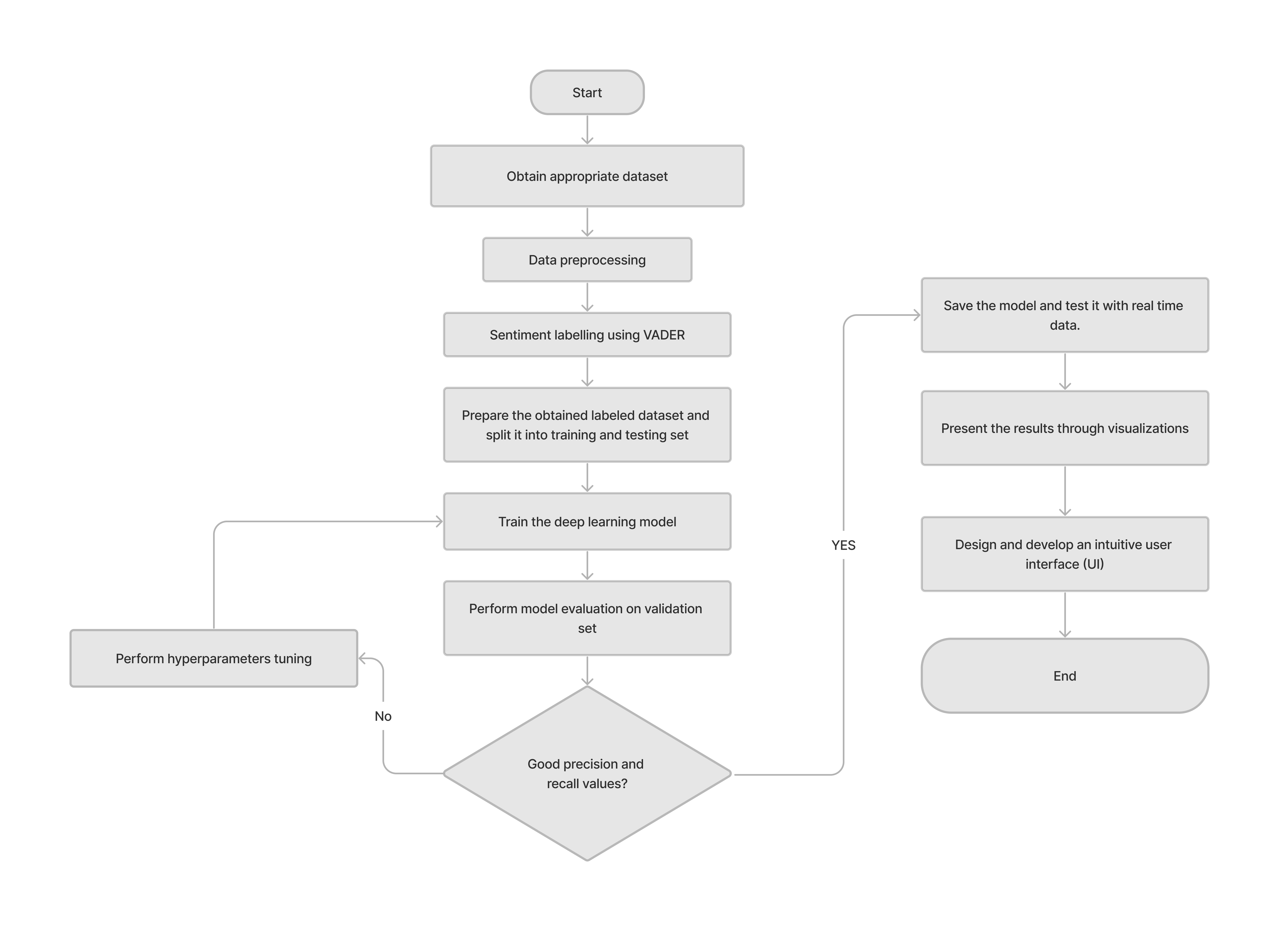
Block Diagram

Slide 9
Expected Outcomes
Accurate sentiment classification, brand perception insights, and real-time analysis capability.
Emphasize the value of insights for brand reputation management and decision-making.
Demonstration of working model
Project Report

Slide 10
Cost Estimation
S.No. | Particulars/Components/Devices | Estimated Cost
1
2
 | Total:
Man hours:
Man hours per week (students): 18 *3 students =72
Man hours per week (faculty): 3

Slide 11
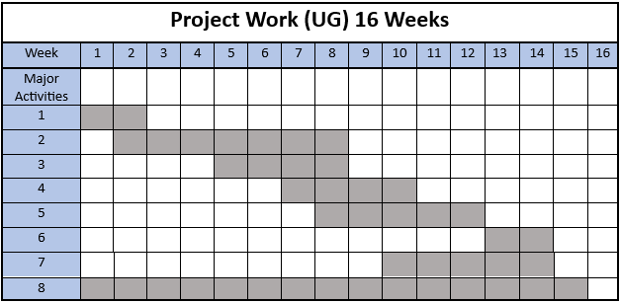
Gantt Chart
Literature review.
Obtain appropriate dataset and data-preprocessing.
Sentiment labelling using VADER.
Training the dataset with ML algorithm.
Model evaluation on validation set.
Real-time testing.
Design and development of UI.
Report Preparation.

Slide 12
References
YouTube Sentiment Analysis and Topic Modeling on Healthcare Products: https://repository.ihu.edu.gr/xmlui/bitstream/handle/11544/30285/Anastasiou_Panagiota_Dissertation_3308200001.pdf?sequence=1
Comparison of Neural Network Models for Sentiment Analysis: https://dergipark.org.tr/en/download/article-file/1506505

Slide 13
Thank You

